Slide 1
STUDENTS: Student 1, Student 2, Student 3, Student 4 [BEng (Hons) Information and Communications Technology (Information Security)]
Your Interesting Project Title Goes Here

Slide 3
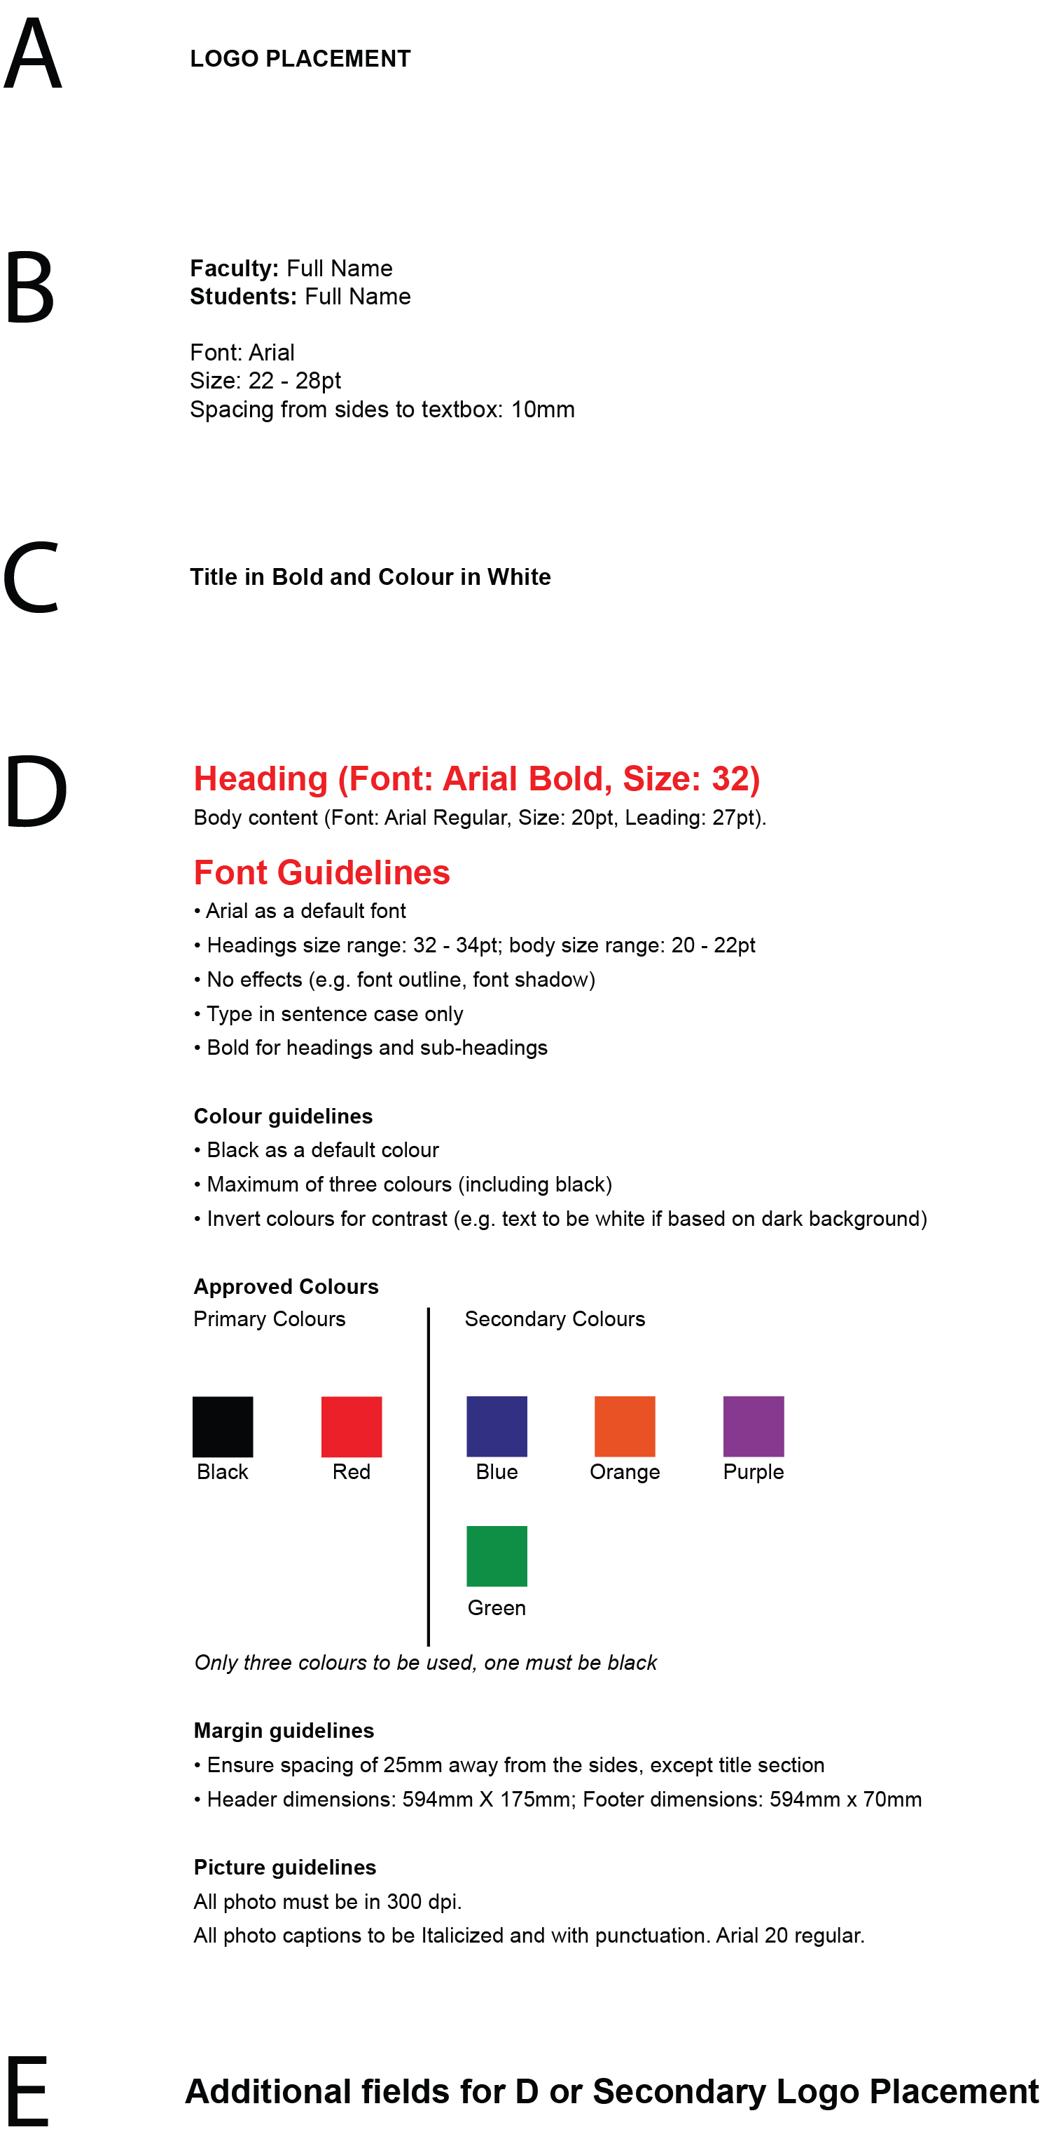
Notes:
A – LOGO PLACEMENT
B – Names
Faculty: Full Name
Students: Full Name
Font: Arial
Size: 22 - 28pt
Spacing from sides to textbox: 10mm
C – Names
Title in Bold and Colour in White
D – Content
Heading (Font: Arial Bold, Size: 32)
Body content (Font: Arial Regular, Size: 20pt, Leading: 27pt).
Font Guidelines
• Arial as a default font
• Headings size range: 32 - 34pt; body size range: 20 - 22pt
• No effects (e.g. font outline, font shadow)
• Type in sentence case only
• Bold for headings and sub-headings
Colour guidelines
• Black as a default colour
• Maximum of three colours (including black)
• Invert colours for contrast (e.g. text to be white if based on dark background)
Approved Colours
Only three colours to be used, one must be black
Margin guidelines
• Ensure spacing of 25mm away from the sides, except title section
• Header dimensions: 594mm X 175mm; Footer dimensions: 594mm x 70mm
Picture guidelines
All photo must be in 300 dpi.
All photo captions to be Italicized and with punctuation. Arial 20 regular.
Primary Colours: Black Red
Secondary Colours: Green Blue Orange Purple
E - Additional fields for D or Secondary Logo Placement

